Slide 1
Photomicrographs of Plant foods
Potato: Sweet & White
Permission to reproduce original photomicrographs used to make this collection may be obtained from
Dr. David O. Norris at
david.norris@colorado.edu

Slide 2
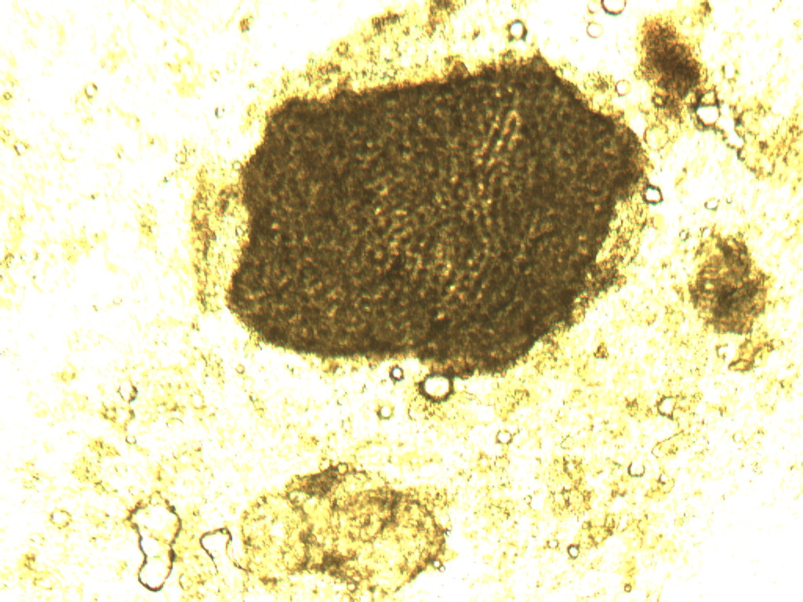
Notes:
412. Ipomoea batatas (L.) Lam Potato, sweet. Skin, 10X.

Slide 3
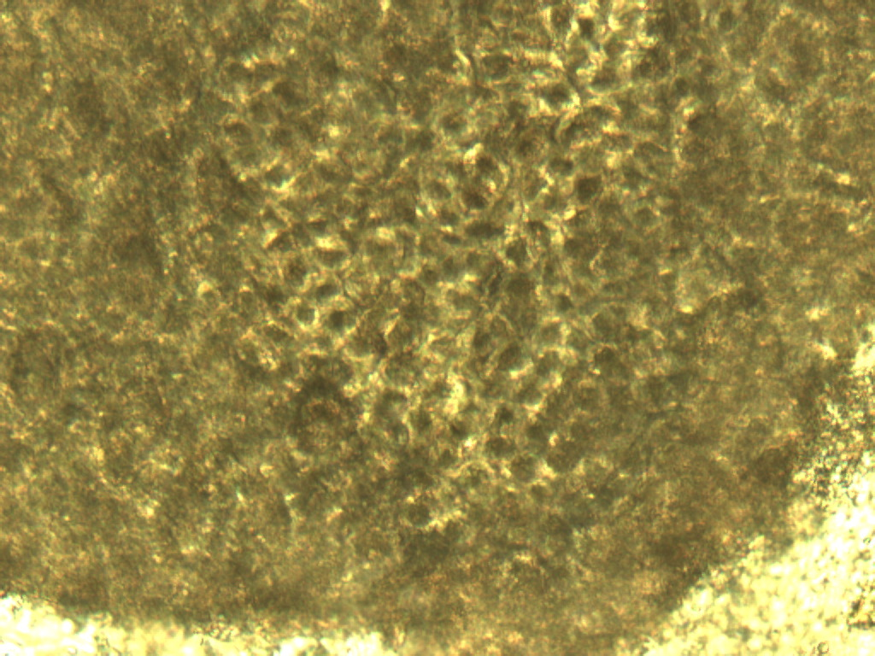
Notes:
413. Potato, sweet. Skin, 25X.

Slide 4
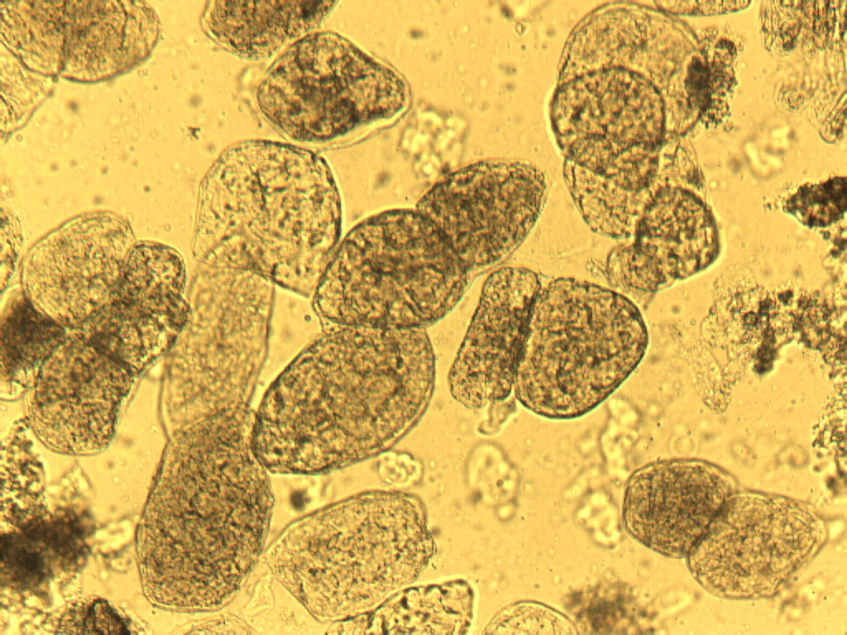
Notes:
413. Potato, sweet. Cooked parenchymal cells, 10X.

Slide 5
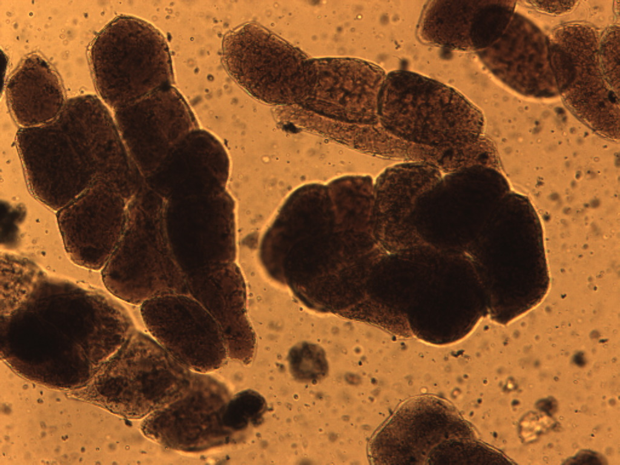
Notes:
414. Potato, sweet. Cooked parenchymal cells stained for starch, 10X.

Slide 6
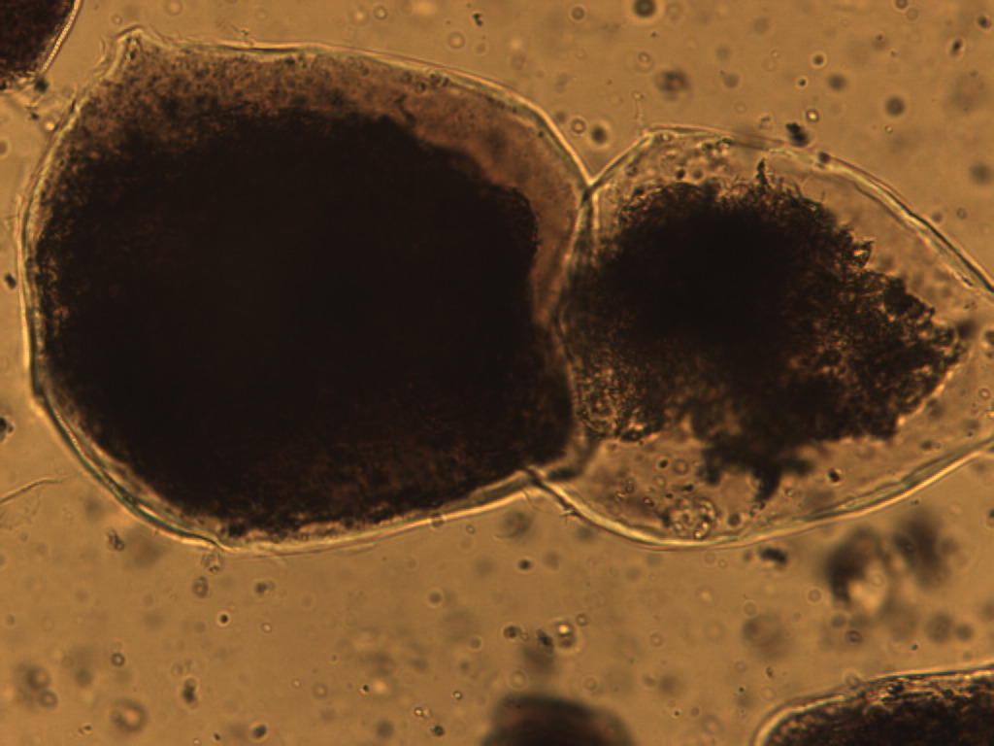
Notes:
415. Potato, sweet. Cooked parenchymal cell stained for starch, 25X. Compare to apple and white potato.

Slide 7
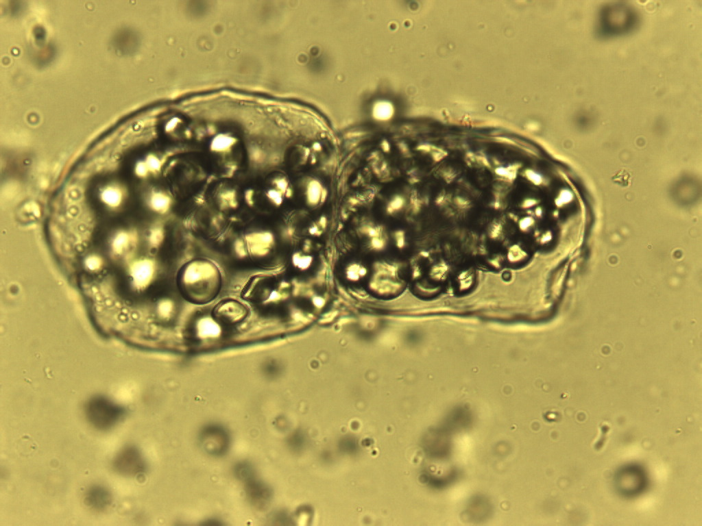
Notes:
416. Potato, sweet. Raw parenchymal cells, 25X

Slide 8
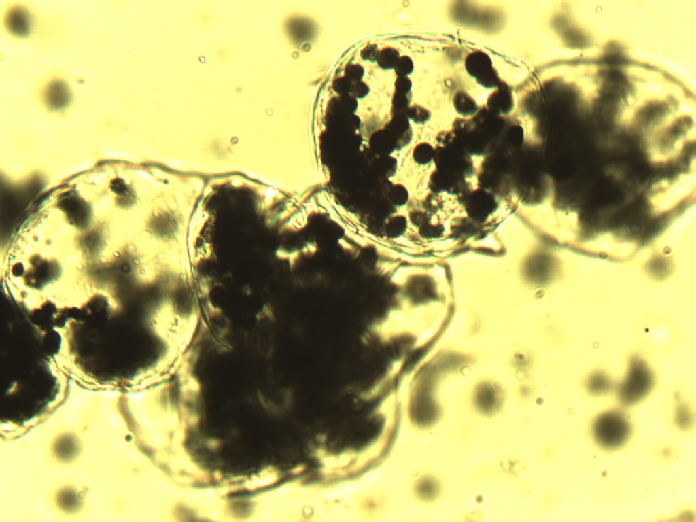
Notes:
417. Potato, sweet. Raw parenchymal cells stained for starch (arrows), 25X.

Slide 9
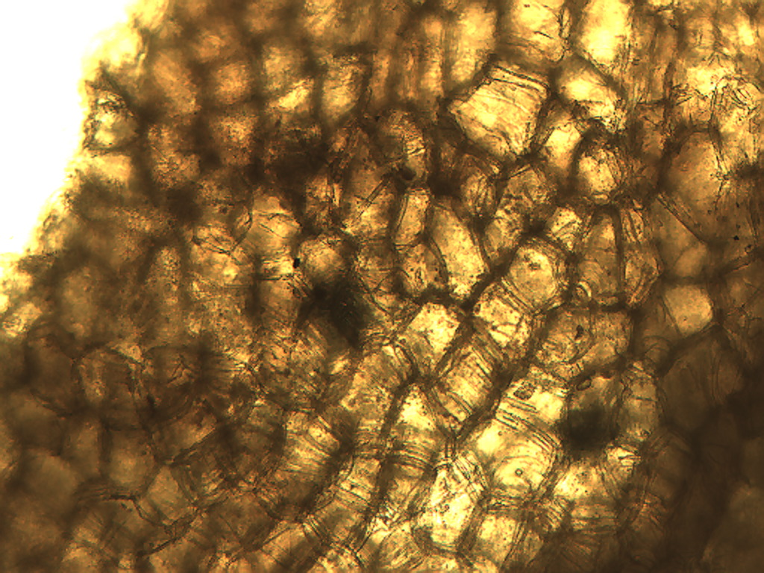
Notes:
420. Solanum tuberosum L. Potato, white. Skin, 10X.

Slide 10
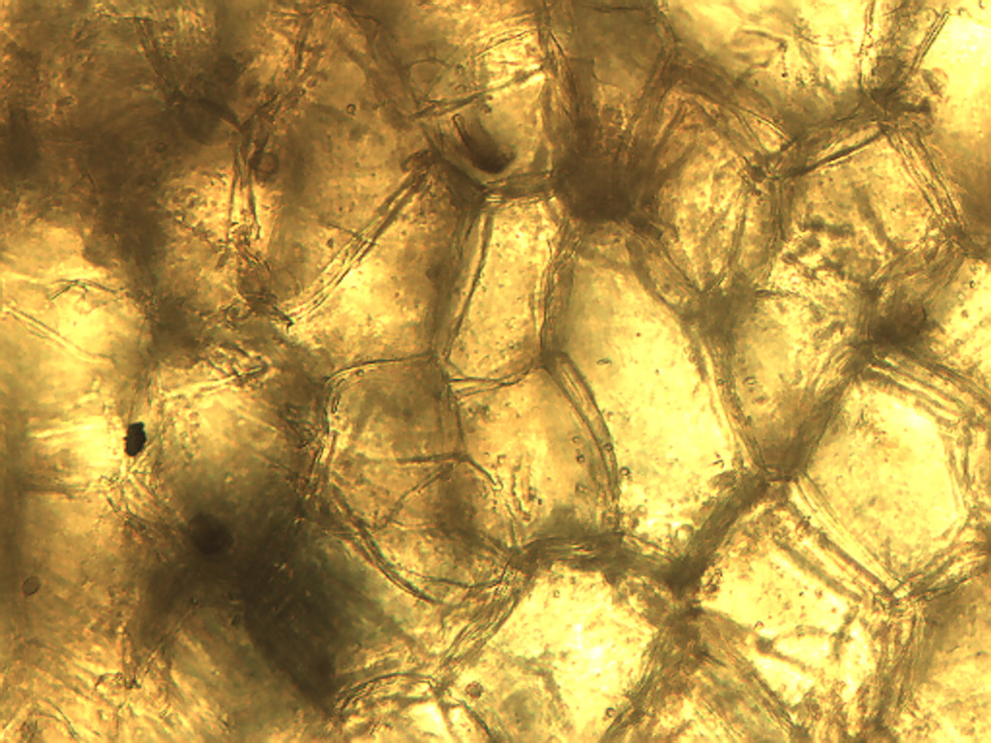
Notes:
421. Potato, white. Skin, 25X.

Slide 11
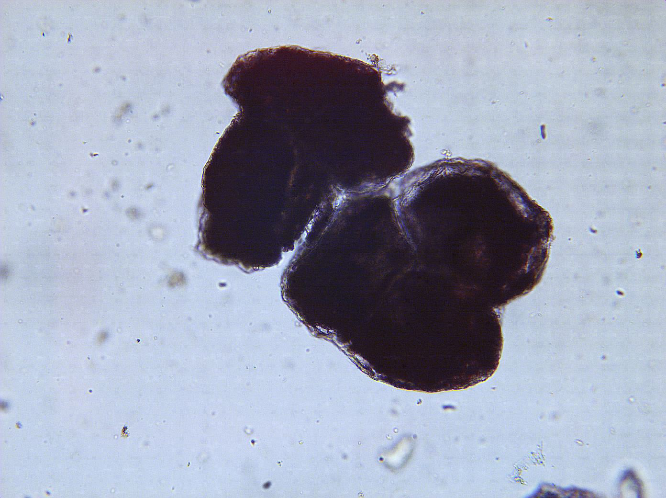
Notes:
418. Potato, white. Parenchymal cells stained for starch, 10X.

Slide 12
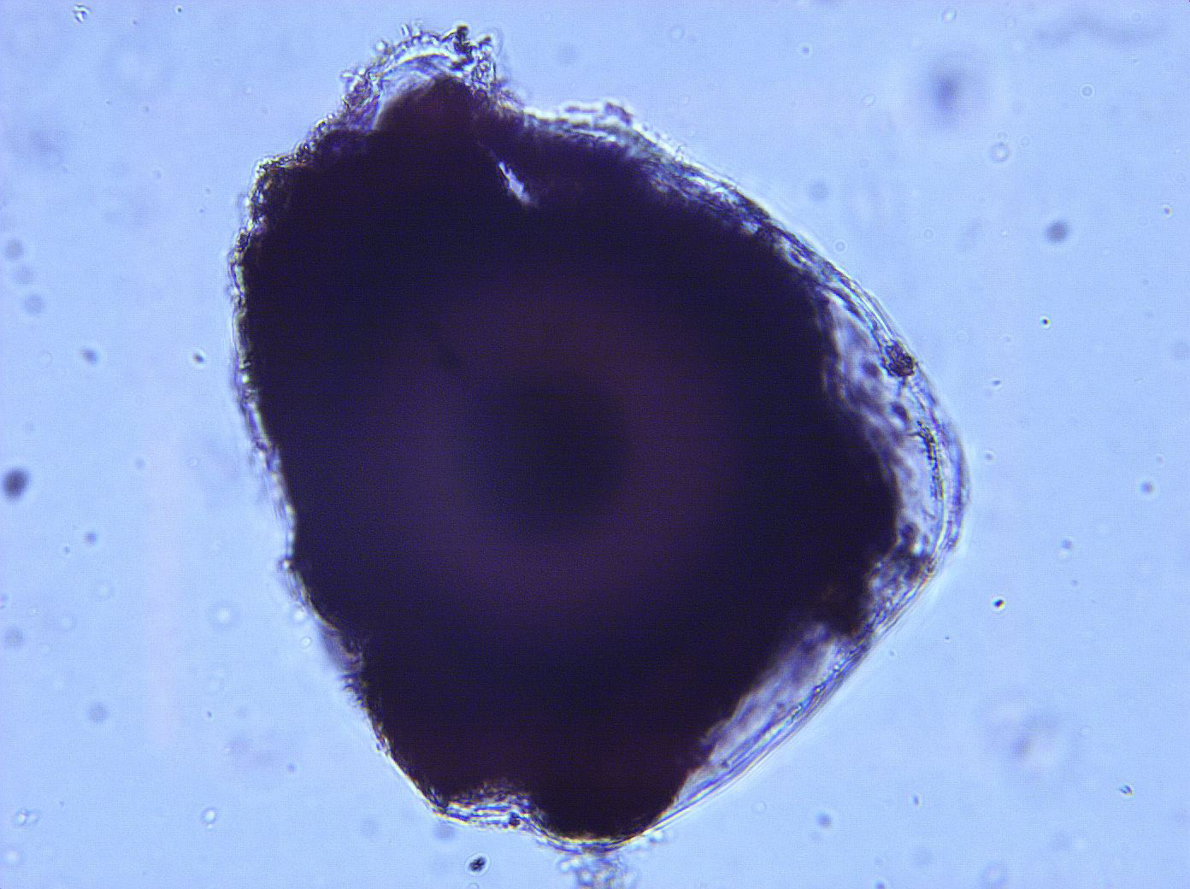
Notes:
419. Potato, white. Parenchymal cells stained for starch, 25X

